Slide 1
VEHICLE RESALE VALUE PREDICTION
UNDER GUIDANCE OF: Mrs Vijaya Bharathi Manjeti
Assistant Professor
BATCH 05
GUREDDY VISHNU VAMSHI REDDY
121710312022
PEDDINENI LIKHITHA CHOUDARY
121710312040
CHITNEEDI JITHENDRA VENKAT
121710312060
GAURAV KUMAR YADAV
121710312018

Slide 2
TOPICS TO BE DISCUSSED
What is ML?
Abstract
Existing problem
Flow chart of proposing model
Block diagram of our model
Proposed solution
Technologies used
Algorithms used
UML diagrams
Result
Conclusion
References

Slide 3
WHAT IS ML?
Machine learning is the concept that a computer program can learn and adapt to new data without human intervention. Machine learning is a field of artificial intelligence (AI) that keeps a computer’s built-in algorithms current regardless of changes in the worldwide economy.

Slide 4
ABSTRACT
The focus of this project is developing machine learning models that can accurately predict the price of a used vehicle based on its features, in order to make informed purchases. We implement and evaluate various learning methods on a dataset consisting of the sale prices of different vehicles and models. Our results show that Random Forest model regression yield the best results than Decision Tree Regression yield and multi linear regression.

Slide 5
EXISTING PROBLEM
Due to the increased price of new vehicles and the incapability of customers to buy new vehicles due to the lack of funds, used vehicle sales are on a global increase. There is a need for a used vehicle price prediction system to effectively determine the worthiness of the vehicle using a variety of features. Though there are websites that offers this service, their prediction method may not be the best. It is important to know vehicle’s actual market value while both buying and selling.

Slide 6
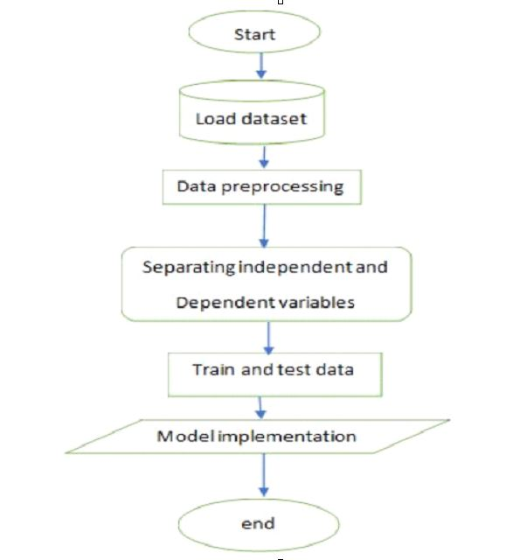
FLOWCHART OF PROPOSING MODEL

Slide 7
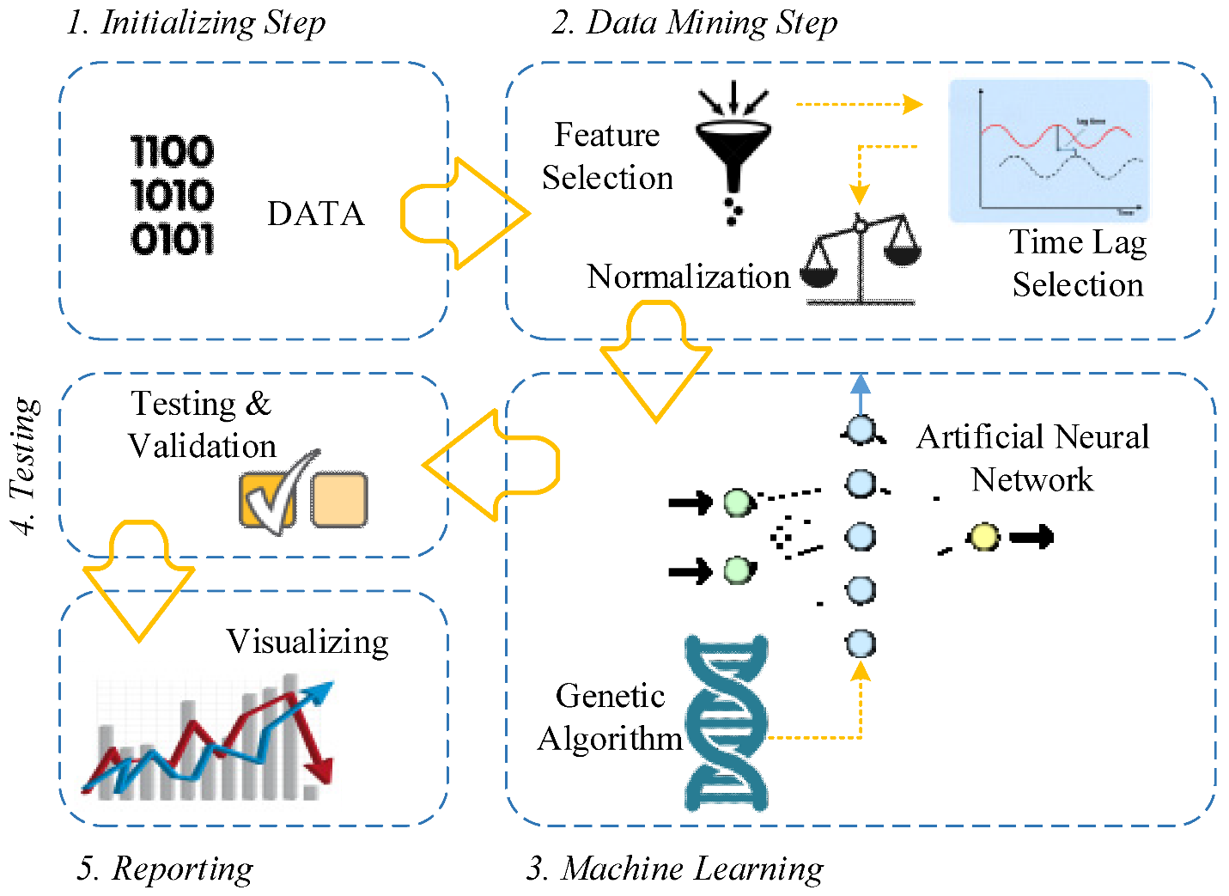
BLOCK DIAGRAM
OF OUR MODEL

Slide 8
PROPOSED SOLUTION
The proposed solution for this is Random Forest Regression (because the output is continuous, we apply regression.
Regression is continuous output based on independent variables.

Slide 9
TECHNOLOGIES USED
● Spyder Ide
● Machine Learning Algorithms
● Python (pandas, NumPy, matplotlib, seaborn, sklearn)
● HTML
● Flask

Slide 10
ALGORITHMS USED
● Multi Linear regression
● Decision tree regression
● Random forest regression

Slide 11
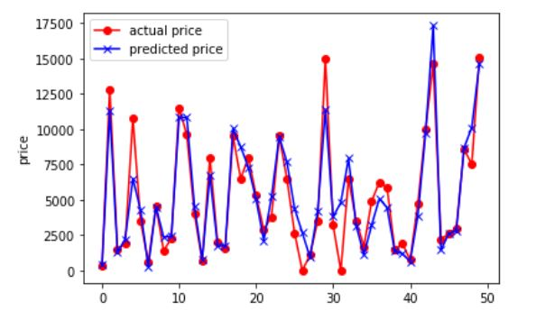
CROSS VALIDATION FOR COMPARING ACTUAL AND PREDICTED VALUES

Slide 12
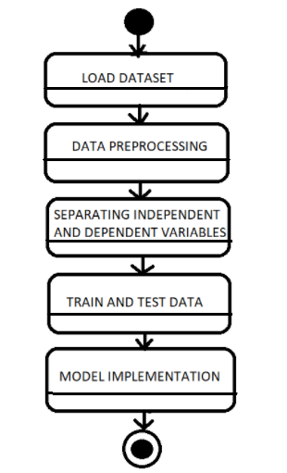
UML DIAGRAMS
STATE CHART DIAGRAM
It shows a behavioral model consisting of states of the system.

Slide 13
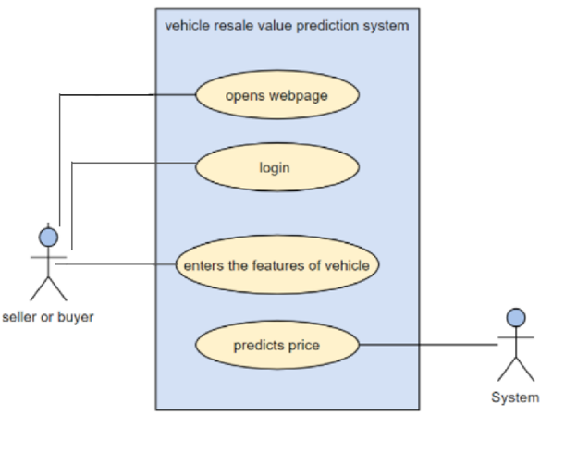
USE CASE DIAGRAM
It’s a written description of how users will interact with the system

Slide 14
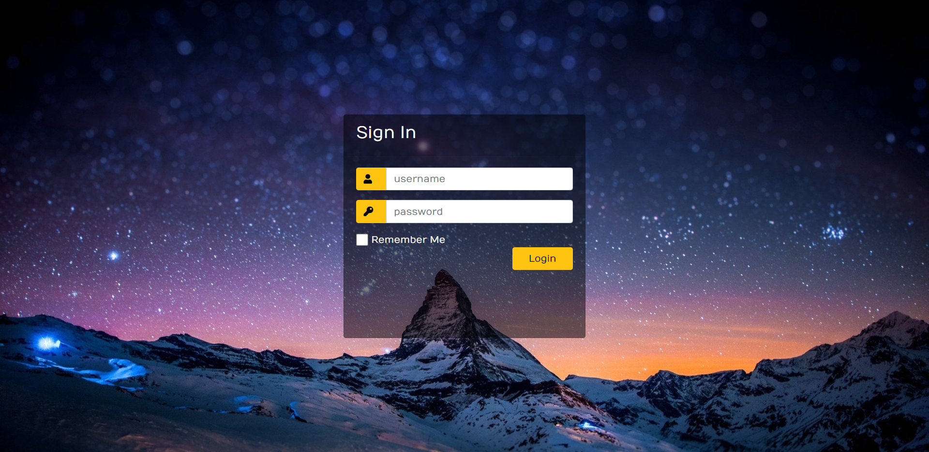
PROJECT OUTPUT

Slide 15
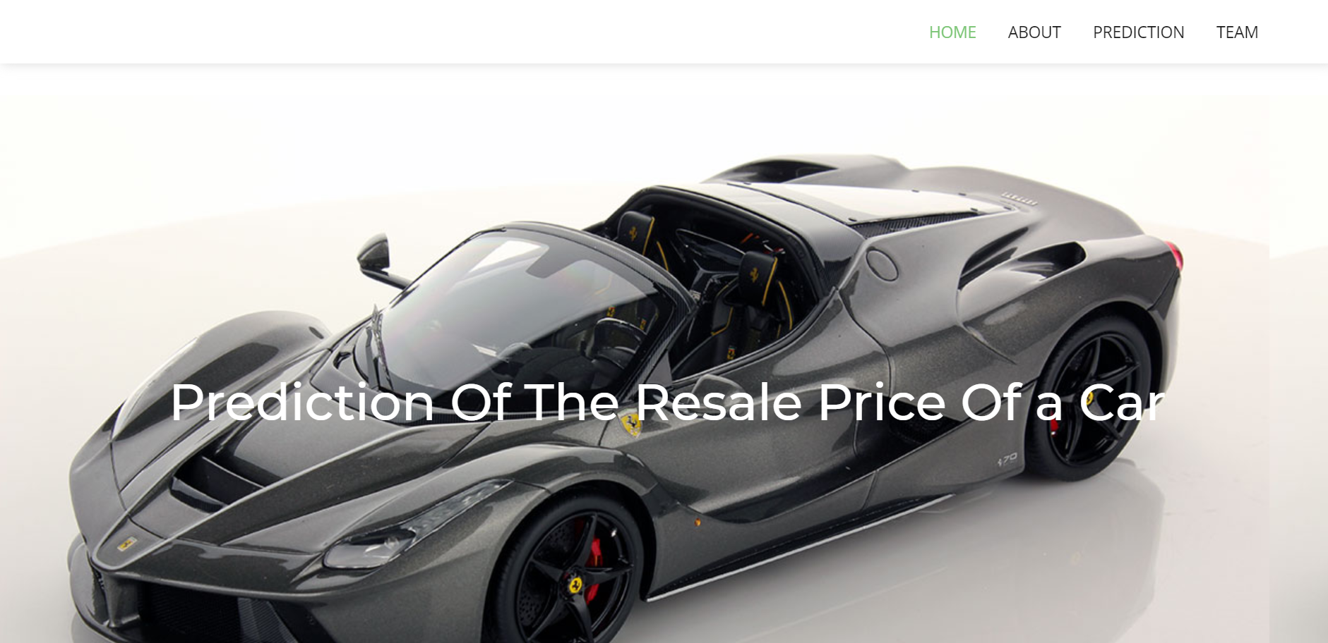

Slide 16
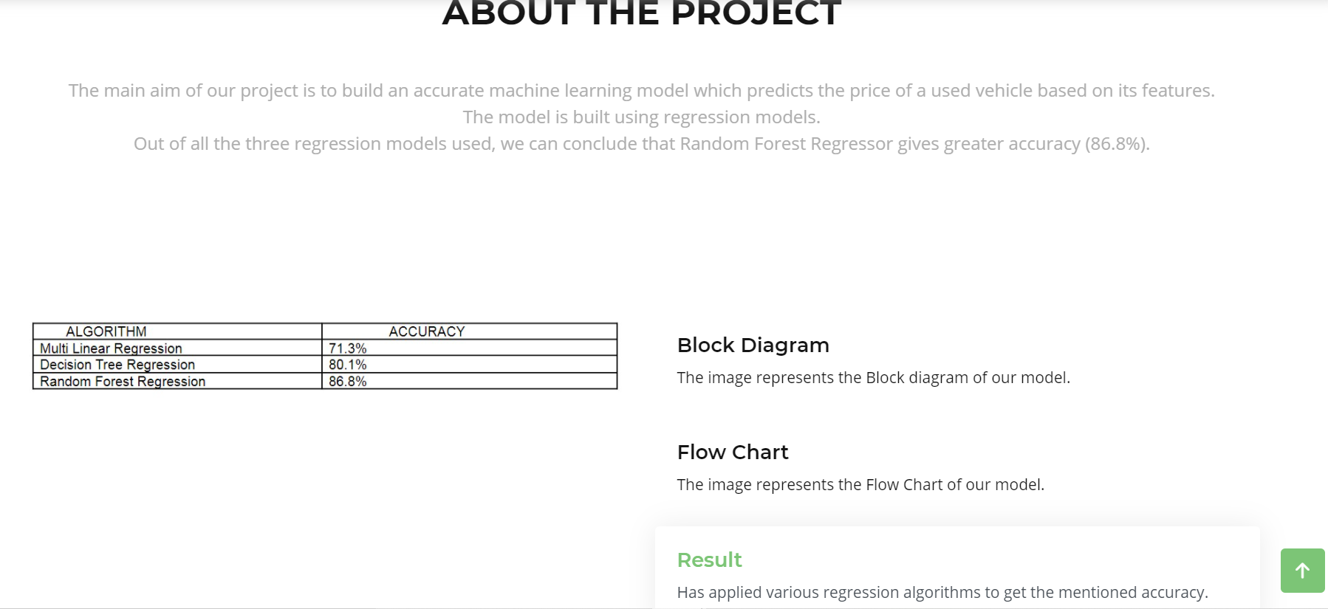

Slide 17
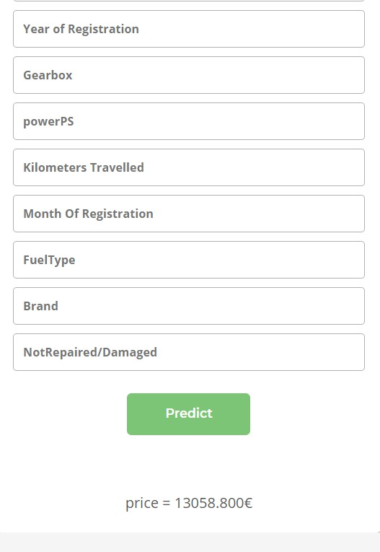

Slide 18
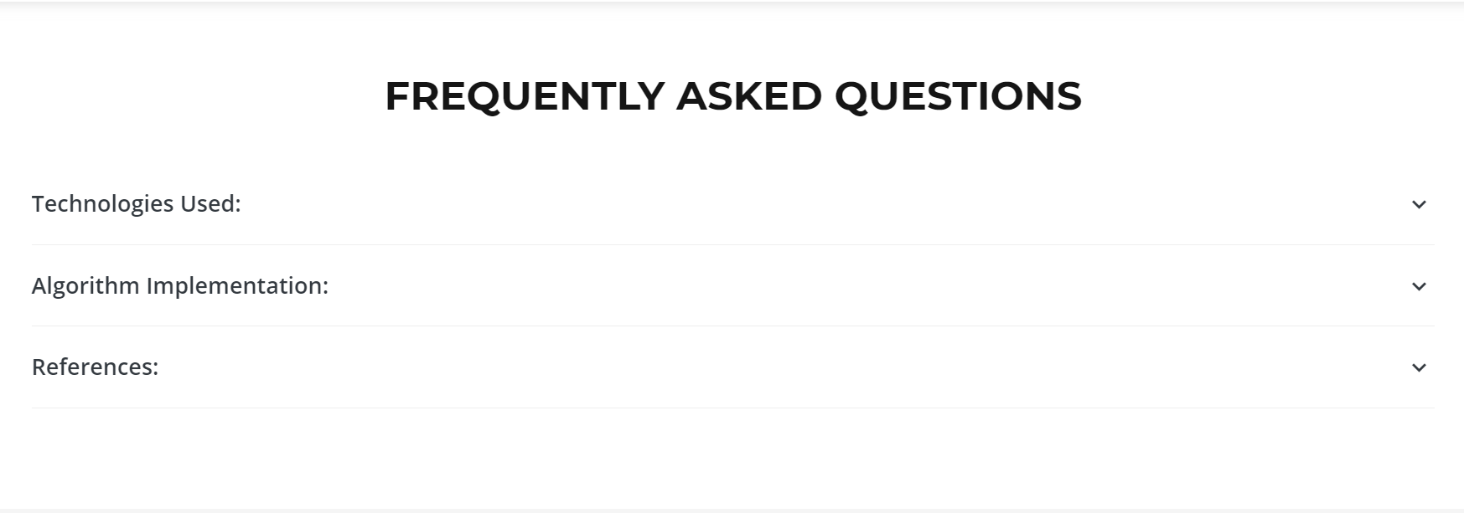

Slide 19
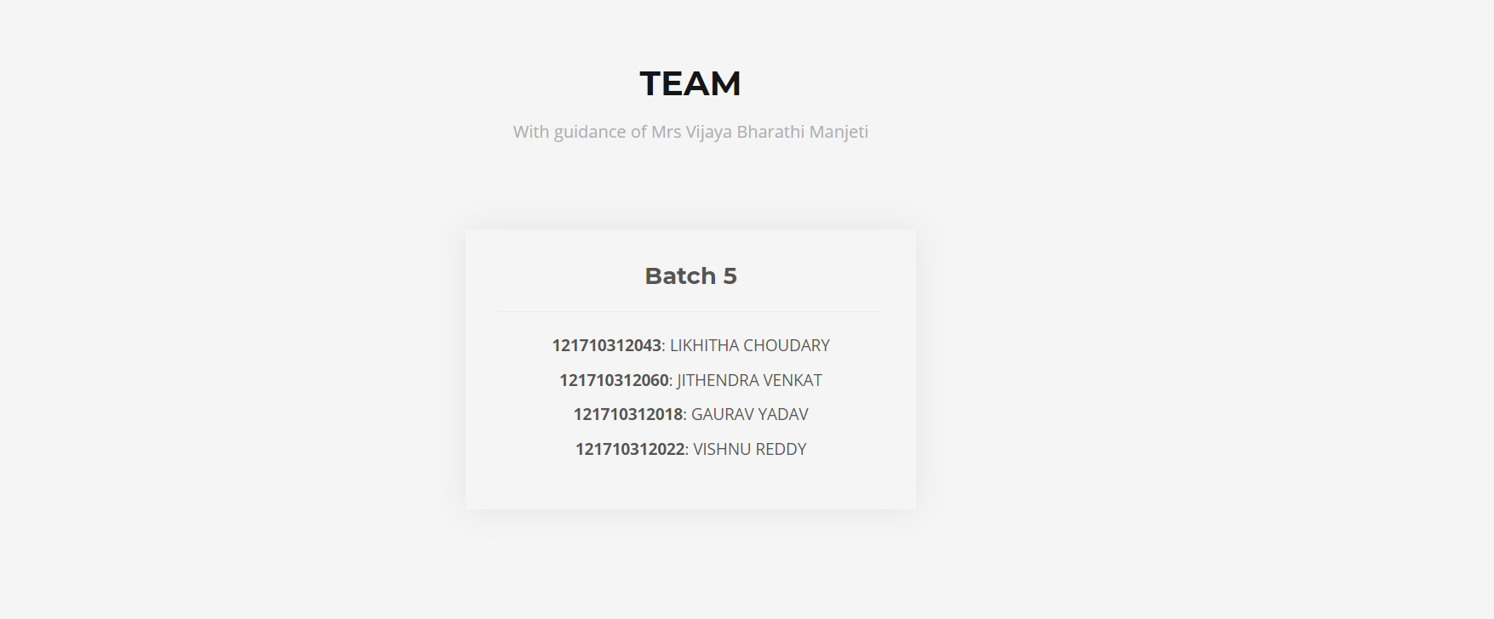

Slide 20
RESULT
Since we have to predict the price of a vehicle which is a continuous value, we have used regression technique to solve this problem. We have applied various regression algorithms as follows:
ALGORITHM | ACCURACY
Multi Linear Regression | 71.3%
Decision tree Regression | 80.1%
Random forest Regression | 86.8%

Slide 21
CONCLUSION
The main aim of this project is to build an accurate machine learning model which predicts the price of a used vehicle based on its features. The model is built using regression models. Out of all the three regression models used, we can conclude that Random Forest Regressor gives greater accuracy

Slide 22
REFERENCES
https://towardsdatascience.com/predicting-used-car-prices-with-machine-learning-techniques-8a9d8313952
https://www.kaggle.com/orgesleka/used-cars-database
https://www.temjournal.com/content/81/TEMJournalFebru
https://www.ijcseonline.org/pub_paper/74-IJCSE-07

